Slide 1


Customer Shopping Behavior Analysis
Analyzing 3,900 purchases to uncover insights into spending patterns, customer segments, product preferences, and subscription behavior for strategic business decisions.

Slide 2

Project Overview & Dataset Summary
Project Goal
Uncover insights from transactional data to guide strategic business decisions.
Dataset Size
3,900 rows, 18 columns of transactional data.
Key Features
Demographics, purchase details, shopping behavior.
Missing Data
37 values in 'Review Rating' column.

Slide 3
Exploratory Data Analysis (Python)
01
02
03
Data Loading & Initial Exploration
Missing Data Handling
Column Standardization
Imputed 'Review Rating' using median per product category.
Renamed columns to snake_case for readability.
Imported dataset, checked structure and summary statistics.
04
05
Feature Engineering
Database Integration
Created 'age_group' and 'purchase_frequency_days'.
Loaded cleaned data into PostgreSQL for SQL analysis.

Slide 4
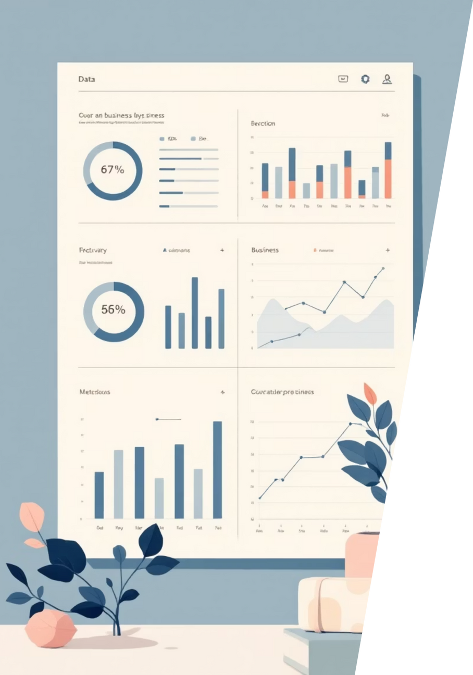




Key SQL Analysis Findings
Revenue by Gender
Male customers generated higher revenue ($157,890) than female ($75,191).
High-Spending Discount Users
Identified 839 customers who used discounts but spent above average.
Top 5 Products by Rating
Gloves, Sandals, Boots, Hat, Skirt had highest average review ratings.
Shipping Type Comparison
Express shipping users had slightly higher average purchase amounts ($60.48) than Standard ($58.46).

Slide 5
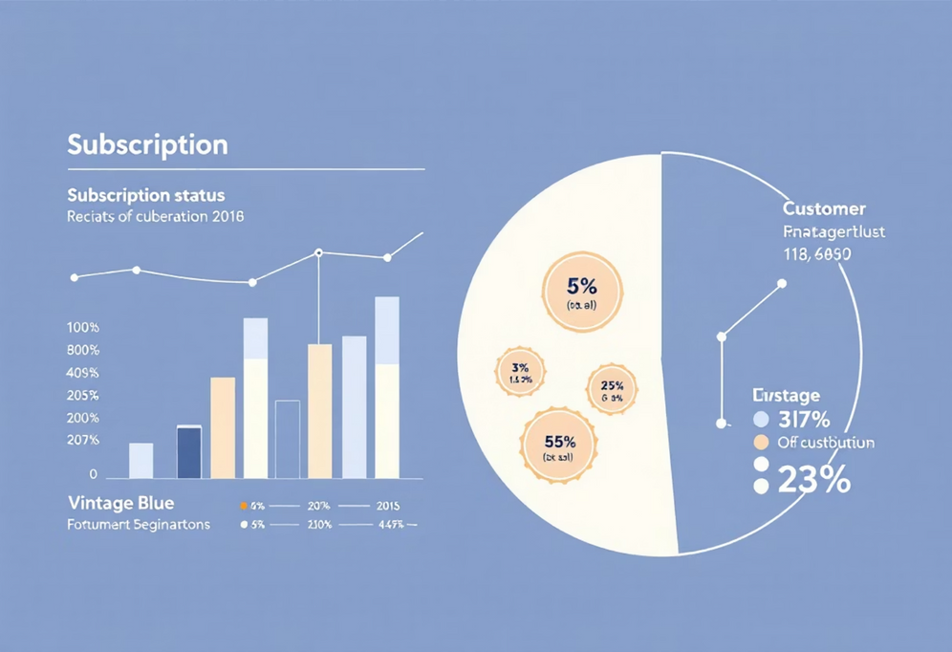
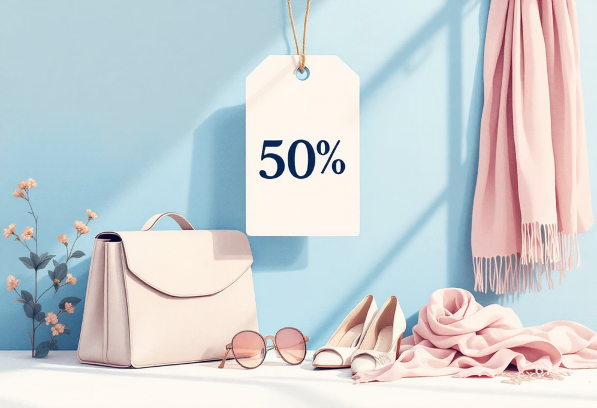
Subscription & Discount Insights
Subscribers vs. Non-Subscribers
Discount-Dependent Products
Non-subscribers had higher total revenue ($170,436) and slightly higher average spend ($59.87) compared to subscribers ($62,645 total, $59.49 avg).
Top 5 products with highest percentage of discounted purchases: Hat (50%), Sneakers (49.66%), Coat (49.07%), Sweater (48.17%), Pants (47.37%).

Slide 6




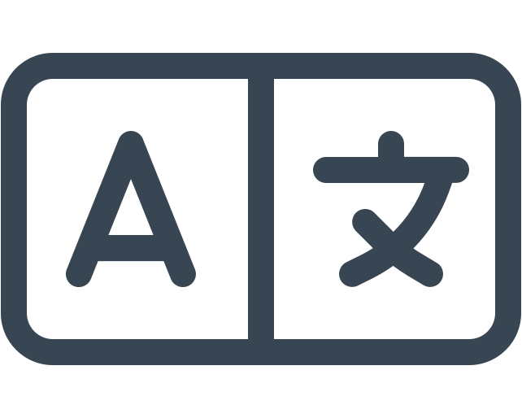

Customer Segmentation & Age Group Revenue
New
83 customers
Loyal
3116 customers
Returning
701 customers
Revenue by Age Group
Young Adults (62,143) and Middle-aged (59,197) are highest revenue contributors.

Slide 7
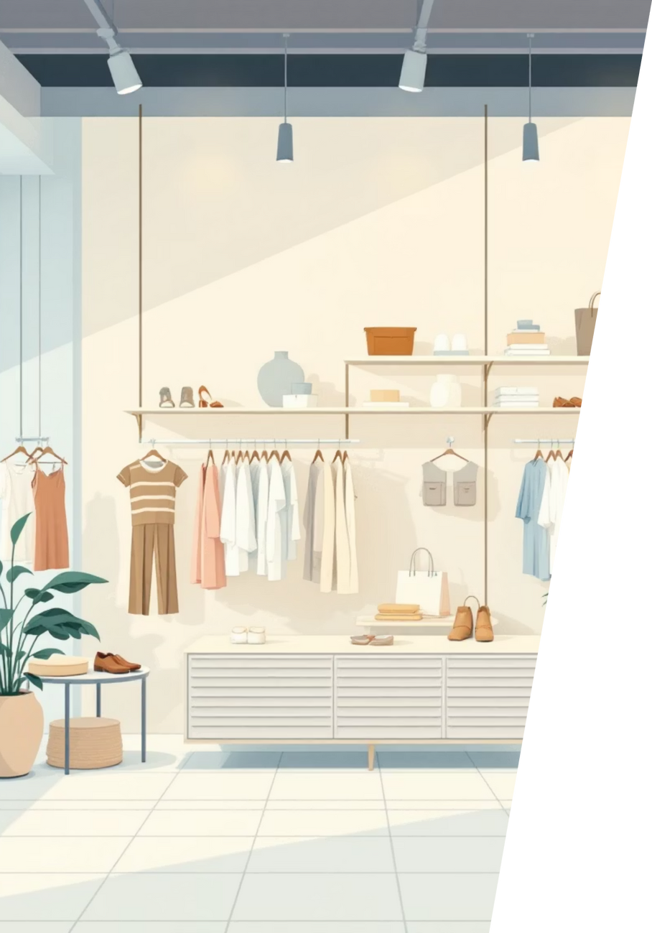
Top Products by Category
Accessories
Jewelry (171 orders)
1
Sunglasses (161 orders)
Belt (161 orders)
Clothing
Blouse (171 orders)
2
Pants (171 orders)
Shirt (169 orders)
Footwear
Sandals (160 orders)
3
Shoes (150 orders)
Sneakers (145 orders)
Outerwear
4
Jacket (163 orders)
Coat (161 orders)

Slide 8


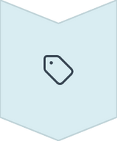


Business Recommendations
Boost Subscriptions
Promote exclusive benefits for subscribers.
Customer Loyalty Programs
Reward repeat buyers to foster loyalty.
Review Discount Policy
Balance sales boosts with margin control.
Product Positioning
Highlight top-rated and best-selling products.
Targeted Marketing
Focus on high-revenue age groups and express-shipping users.

